Slide 1
Using Evidence & Theories to Inform Adaptation
Using Evidence & Theories to Inform Adaptation
Notes:
Welcome to session 4 of Base Camp.

Slide 2
Disclosure
This session was supported by Cooperative Agreement #NU58DP006461-03 from the Centers for Disease Control and Prevention (CDC). The views expressed in written workshop materials or publications and by speakers and moderators do not necessarily reflect the official policies of the Department of Health and Human Services, nor does the mention of trade names, commercial practices, or organizations imply endorsement by the U.S. Government.
Notes:
This session was supported by a Cooperative Agreement from the Centers for Disease Control and Prevention (CDC). The views expressed in written workshop materials or publications and by speakers and moderators do not necessarily reflect the official policies of the Department of Health and Human Services, nor does the mention of trade names, commercial practices, or organizations imply endorsement by the U.S. Government.

Slide 3
Learning Objectives
Identify key process components of adapting an Evidence Based Intervention (EBI)
Notes:
Our main learning objectives for this session include:
Identifying key process components involved in adapting an EBI

Slide 4
Session Agenda
Introduce adaptation process
Notes:
Here is our map for the session:
We will introduce the adaptation process.

Slide 5
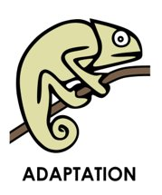
Evidence Meets Context
Adaptations are often needed to ensure that interventions are feasible and ‘fit’ the population of focus and setting…
Tu et al., 2014
Escoffrey et al., 2018
Notes:
Adaptations are often needed to ensure that interventions are feasible and ‘fit’ the population of focus and setting. This can be a vital step in planning for health equity in your intervention, where you can plan ahead to adapt for your population(s) of focus.
Adaptation is defined as the degree to which an evidence-based intervention is changed or modified by a user during adoption and implementation to suit the needs of the setting or to improve the fit to local conditions.
Fidelity, a related term, is the degree to which an intervention or program is implemented as intended by the developers and as prescribed in the original protocol.
Example: For example, say the cancer screening program you are working with is needing to be carried out in a new setting because of system changes such as a Federally Qualified Health Center being too overwhelmed at the moment. Maybe you want to carry out the FLU-FIT program at a workplace or at a pharmacy which is more accessible and a better fit for your context. What should you take into consideration before carrying out changes like this? This session will help you plan these changes in advance.

Slide 6
Situations to Look Out For:
Voltage Drop: When interventions are less effective in the real world outside the research setting
Lack of champions who are willing to be trained in the screening program
Drift: When changes to a program make it less effective (i.e., deletion of core components)
Lack of attention to behavioral change framework in a smoking cessation program
Chambers et al., 2013
Notes:
Here we will introduce two more concepts that help explain why being intentional about adaptation is so important.
(Click)
Voltage Drop occurs when interventions are less effective in real world practice than they are in a research setting, because research settings are sometimes better resourced with special conditions that a real world setting might not be able to replicate day to day.
An example could be a lack of champions who are willing to be trained in a screening program, and therefore the program is not as effective as in a clinical trial.
(Click)
Drift on the other hand results from adapting an intervention in a way that changes the program’s effectiveness – such as deleting a core component of a program that makes it work
An example might be a lack of adherence to the behavioral change framework in a smoking cessation program
Maybe clinicians do not fully understand the theories underlying a cessation program and have changed the components so much that it is not producing effective outcomes

Slide 7
Steps in the Adaptation Process
Understand the “Why”: What theories support intervention?
Understand core components and risks of adapting these
Document adaptations and measure fidelity
Implementation quality
Notes:
Some steps in the adaptation process:
(Click)
Understand the “Why”: What theories support intervention?
(Click)
Understand core components and risks of adapting these
(Click)
Document adaptations and measure fidelity. This will help you understand the quality of implementation.

Slide 8
Steps in the Adaptation Process
Understand the “Why”: What theories support intervention?
Understand core components and risks of adapting these
Document adaptations and measure fidelity
Implementation quality
Notes:
First—let’s look at why.

Slide 9
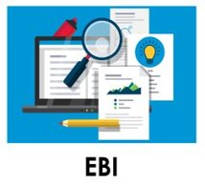
Understand the “Why”
Interventions are designed around models of behavioral change
Designed to address a barrier or cause of behavior
Designed intentionally for multiple levels of change
Notes:
EBIs are grounded in theory, that is the foundation of why they work the way they do.
Interventions are designed around models of behavioral change
They may be carefully designed to address a barrier or cause of behavior
They may also sometimes be designed to address multiple levels of change
Maybe they act on a specific barrier or determinant of behavior, which causes the intervention to be effective.
Do we want to change that function?
No

Slide 10
“Why do I need to know why?”
“Public health interventions grounded in health behavior theory often prove to be more effective than those lacking a theoretical base, because these theories conceptualize the mechanisms that underlie behavior change.”
ICEBeRG Group, 2006
Jacobs et al., 2012
Notes:
Why does this matter?
“Public health interventions grounded in health behavior theory often prove to be more effective than those lacking a theoretical base, because these theories conceptualize the mechanisms that underlie behavior change.”

Slide 11
Steps in the Adaptation Process
Understand the “Why”: What theories support intervention?
Understand core components and risks of adapting these
Document adaptations and measure fidelity
Implementation quality
Notes:
Next, we will look at core and adaptable components of interventions.

Slide 12
Intervention Form and Function
Components:
Setting
Dose/ Timeline
Behavioral model or theory
Population of focus
Content
Cultural tailoring for population of focus
Function: Core Components
Form: Adaptable Components
Dose/Timeline
Behavioral Model or Theory
Content
Setting
Population of focus
Cultural tailoring for population of focus
Escoffery et al., 2018
Hartman et al., 2015
Movsisyan et al., 2019
Moore and Metz, 2020
Notes:
We do not want to change the function of the EBI as it is the core reason why the program works, or is effective. Changing the form, or the adaptable components of an EBI, does not change the function.
Let’s match what you think might be a core component or functional component of an intervention, versus what you think might be adaptable components.
We will start with the first word from the list on the right---”setting”. (Work through list) (Click)

Slide 13
Traffic Light Model
Minor changes
Program names
Updating statistics
Tailoring content
Adding or modifying flexible components
Activities, sequence, audience, delivery format, delivery person
Changing core elements or theory/ model
Deleting core components
Timeline
Dose
Balis et al., 2021
NCI, 2019
Notes:
As we just learned, making too many changes to an intervention can reduce its original effectiveness, or worse, introduce unintended and harmful outcomes.
Before making adaptations to the intervention, you should think about how the change to the original intervention can improve the fit to your community, setting, or population of focus, and at the same time, maintain fidelity to the core components of the original intervention.
Think of possible adaptations as you would a green, yellow, or red traffic light:
(Click) green light changes are usually OK to make;
(Click) yellow light changes should be approached with caution; and
(Click) red light changes should be avoided when possible.

Slide 14
Steps in the Adaptation Process
Understand the “Why”: What theories support intervention?
Understand core components and risks of adapting these
Document adaptations and measure fidelity
Implementation quality
Notes:
Last, we will introduce some tools for documenting adaptations and measuring fidelity.

Slide 15
Document Adaptations
Be Proactive:
Make adaptations to promote acceptance
Design implementation blueprint to allow for EBI adaptation in an intentional way
Kilbourne at al., 2020
Aarons et al., 2012
Notes:
Be intentional in the design of adaptations in your implementation blueprint
Make adaptations to promote end-user acceptance from the start.
Maybe you know will be working with a specific population of focus that will require minor changes and cultural tailoring of content and activities. It is better to include populations most affected by the planned intervention early and document changes and reasons for changes proactively

Slide 16
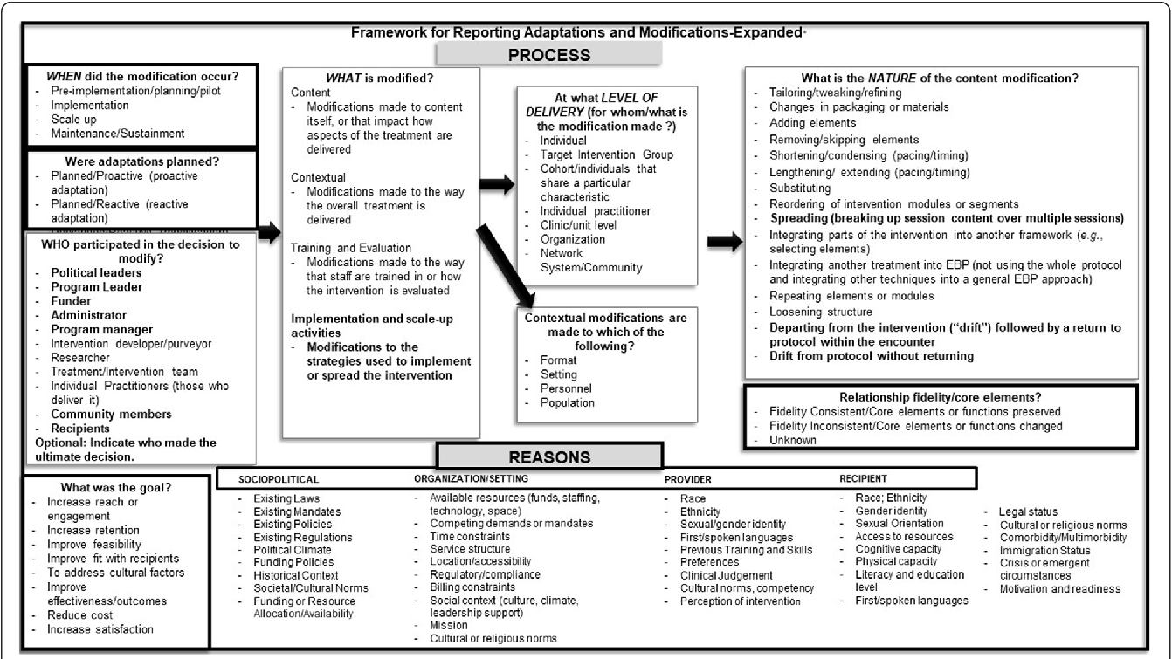
Framework for Reporting Adaptations and Modifications (FRAME)
Wiltsey et al., 2019
Notes:
One example of a framework for documenting adaptations is the FRAME. See here a picture of the template/tool available for your use in adapting interventions. This tool contains prompts to remind you to document when adaptations occurred, who decided to modify an intervention, as well as the nature of the changes made. This tool is also located in the supplemental resources.

Slide 17
Tools and Supplemental Resources
IM Adapt
Make It Your Own Tool
Model for Adaptation Design and Impact Guide
National Cancer Institute Guidelines for Choosing and Adapting Programs
National Cancer Institute Theory at a Glance: A Guide for Health Promotion Practice
Planning Health Promotion Programs: An Interventions Mapping Approach, 4th Edition
Notes:
Tools listed here are all located in your companion guide for your continued learning

Slide 18
Tools and Supplemental Resources
AcademyHealth Blog Post “Implementation Science: Embracing Adaptations to Complex Interventions for Better Outcomes”
Stirman, S. W., Baumann, A. A., & Miller, C. J. (2019). The FRAME: An expanded Framework for Reporting Adaptations and Modifications to Evidence-based interventions. Implementation Science, 14(1). https://doi.org/10.1186/s13012-019-0898-y

Slide 19
References
Aarons, G. A., Green, A. E., Palinkas, L. A., Self-Brown, S., Whitaker, D. J., Lutzker, J., Silovsky, J. F., Hecht, D., &
Chaffin, M. (2012). Dynamic adaptation process to implement an evidence-based child
maltreatment intervention. Implementation Science, 7(32). https://doi.org/10.1186/1748-5908-7-32
Balis, L. E., Kennedy, L. E., Houghtaling, B., & Harden, S. M. (2021). Red, yellow, and green light changes:
Adaptations to extension health promotion programs. Prevention Science. doi: 10.1007/s11121-021-01222-x
Chambers, D. A., Glasgow, R. E., & Stange, K. C. (2013). The dynamic sustainability framework: Addressing the
paradox of sustainment amid ongoing change. Implementation science, 8(117).
https://doi.org/10.1186/1748-5908-8-117
Escoffery C, Lebow-Skelley E, Haardoerfer R, et al. A systematic review of adaptations of evidence-based public health
interventions globally. Implement Sci. 2018;13(1):125. Published 2018 Sep 26. doi:10.1186/s13012-018-0815-9
Hartman, M. A., Stronks, K., Highfield, L. Cremer, S. W., Verhoeff, A. P., & Nierkens, V. (2015). Disseminating
evidence-based interventions to new populations: A systematic approach to consider the need
for adaptation. Implementation Science, 10(49). https://doi.org/10.1186/1748-5908-10-S1-A49
Jacobs, J. A., Jones, E., Gabella, B. A., Spring, B., & Brownson, R. C. (2012). Tools for implementing an evidence-
based approach in public health practice. Preventing Chronic Disease, 9, E116. doi: 10.5888/pcd9.110324
Kilbourne, A. M., Glasgow, R. E. & Chambers, D. A. (2020). What can implementation science do for you? Key
success stories from the field. Journal of General Internal Medicine, 35, 783–787. doi: 10.1007/s11606-020-06174-6
Moore, J. & Metz, A. (2020). Practicing implementation blog:
https://nirn.fpg.unc.edu/practicing-implementation/providing-implementation-support-program-
adaptations-covid-19-Environment.
Notes:
As well as references.

Slide 20
References
Moore, J. & Metz, A. (2020). Practicing implementation blog:
https://nirn.fpg.unc.edu/practicing-implementation/providing-implementation-support-program-
adaptations-covid-19-Environment.
Movsisyan, A., Arnold, L., Evans, R. Hallingberg, B., Moore, G., O’ Cathain, A., Pfadenhauer, L. M., Seegrott
J., Rehfuess, E. (2019). Adapting evidence-informed complex population health interventions for new contexts:
A systematic review of guidance. Implementation Science, 14(105).
https://doi.org/10.1186/s13012-019-0956-5
National Cancer Institute. (2019). Implementation science at a glance.
https://cancercontrol.cancer.gov/sites/default/files/2020-07/NCI-ISaaG-Workbook.pdf
The Improved Clinical Effectiveness through Behavioural Research Group (ICEBeRG). (2006). Designing theoretically-informed implementation interventions. Implementation Science,
1(4). https://doi.org/10.1186/1748-5908-1-4
Tu, S-P., Chun, A., Yasui, Y., Kuniyuki, A., Yip, M., Taylor, V., & Bastani, R. (2014). Adaptation of an
evidence-based intervention to promote colorectal cancer screening: A quasi-experimental
study. Implementation Science 9(85). https://doi.org/10.1186/1748-5908-9-85
Wiltsey Stirman, S., Baumann, A. A. & Miller, C. J. (2019). The FRAME: An Expanded Framework for
Reporting Adaptations and Modifications to Evidence-based interventions. Implementation Science,
14(58). https://doi.org/10.1186/s13012-019-0898-y

Slide 21
Acknowledgments
PI:
Mandi L. Pratt-Chapman PhD
Staff:
Sarah Adler
Joseph Astorino
Leila Habib
Sarah Kerch
Workgroup Members:
Christi Cahill
David Chambers
Tamara Robinson
Randy Schwartz
Notes:
Thank you to all those listed here who helped in developing this training.

