Slide 1
How to find evidence-based interventions for cancer control
How to Find Evidence-Based Interventions for Cancer Control
Notes:
Welcome to session 3 of the Base Camp.
This session will focus on How to find Evidence-Based Initiatives for Cancer Control.

Slide 2
Disclosure
This session was supported by Cooperative Agreement #NU58DP006461-03 from the Centers for Disease Control and Prevention (CDC). The views expressed in written workshop materials or publications and by speakers and moderators do not necessarily reflect the official policies of the Department of Health and Human Services, nor does the mention of trade names, commercial practices, or organizations imply endorsement by the U.S. Government.
Notes:
This session was supported by a Cooperative Agreement from the Centers for Disease Control and Prevention (CDC). The views expressed in written workshop materials or publications and by speakers and moderators do not necessarily reflect the official policies of the Department of Health and Human Services, nor does the mention of trade names, commercial practices, or organizations imply endorsement by the U.S. Government.

Slide 3
Learning Objectives
Describe sources and examples of evidence-based interventions (EBIs)
Notes:
Our main learning objective is that learners should be able to describe sources and examples of evidence-based interventions (EBIs) after this quick session.

Slide 4
Session Agenda
Introduce landscape of evidence
Notes:
Our plan for the session is to introduce the landscape of evidence.

Slide 5
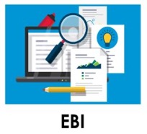
What are Evidence-Based Interventions (EBIs)?
Health-focused interventions with evidence demonstrating the ability to change a behavior or outcome
Jacobs et al., 2012
University of Washington, n.d.
Notes:
EBIs are health-focused interventions with evidence demonstrating the ability to change a behavior or outcome. These come in many different forms such as:
Procedures which are written documents depicting the necessary steps of a practice
Programs: Short-term interventions that create temporary improvements in the wake of challenges.
Products: A thing or object that is a result of productive actions
Policies: policy (little p) is a guiding principle used to set direction in an organization; Policy (big P) guides the rules we collectively choose to live by, as articulated in legislation and regulation. They inform our socially accepted morals and ethics.
Pills: Medicine itself.
Practices: An activity or process
Principles: A high level ideal or value guiding behavior internally

Slide 6
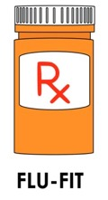
Match the EBI
Product:
Policy:
Program:
Practice:
Word Bank
Colorectal cancer early detection pilot program
Paid time off for screening
Coordinating transportation to colorectal cancer screening
FLU-FIT Kit
FLU-FIT Kit
Paid time off for screening
Colorectal cancer
early detection pilot program
Coordinating transportation to
colorectal cancer screening
Notes:
Now we are going to do a matching game. Match the blue words to the right EBI type. Let’s start with “colorectal cancer early detection pilot program”. Where do you think that would go?
Continue going down the word bank list.

Slide 7
What Does Evidence Mean?
Systematic review: Summaries of evidence made up of multiple studies and recommendations
Guideline synthesis: Synthesis of systematic reviews of research-tested interventions used to help practitioners select interventions for implementation
Jacobs et al., 2012
Notes:
Next we will examine what does evidence even mean?
Two examples of evidence are:
Systematic reviews: Summaries of evidence made up of multiple studies and recommendations
Guideline synthesis: Synthesis of systematic reviews of research-tested interventions used to help practitioners select interventions for implementation

Slide 8
Practice-Based Evidence
Lived experience matters!
Practitioners know their patients, context and needs best
Two-way flow of knowledge can inform implementation
Identify rigorous quality improvement efforts
Get stakeholders involved in evaluation
Co-create with implementation scientists
Green, 2008
Notes:
Practitioners know their setting best therefore lived experience matters.
Practitioners know their patients, context and needs best.
Some ways that this knowledge can inform implementation research include:
-Rigorous quality improvement efforts
-Getting stakeholders involved in evaluation
-Co-creating with implementation scientists
You might ask yourself (or your team): who is critical to the implementation of your cancer screening objective that might have this type of knowledge?

Slide 9
Resources that Synthesize Evidence
The Campbell Corporation
https://www.campbellcollaboration.org
Cochrane Effective Practice and Organization of Care
https://epoc.cochrane.org/
Notes:
There are also many resources that synthesize evidence for you as practitioners. The Campbell Corporation and the Cochrane Group both are useful resources that have already done the work of synthesizing evidence for you.

Slide 10
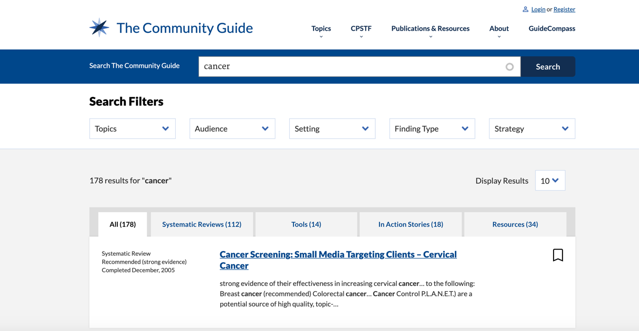
The Community Guide
The Community Guide, n.d.
Notes:
The Community Guide is developed by the Community Preventative Services Task Force and provides evidence-based findings and recommendations about community services, programs, and other interventions aimed at improving population health.

Slide 11
The Community Guide
The Community Guide, n.d.
Notes:
Some examples from the Community Guide include the systematic reviews that recommend interventions that engage community health workers to increase screening for breast, colorectal, and cervical cancer.

Slide 12
Guide to Clinical Preventive Services
Cancer Screening
Breast
Cervical
Lung
Colorectal
A.H.R.Q., n.d.
Notes:
The Guide to Clinical Preventive Services contains the U.S. Preventive Services Task Force (USPSTF) recommendations on the use of screening, counseling, and other preventive services that are typically delivered in primary care settings.

Slide 13
Evidence-Based Cancer Control Programs
National Cancer Institute, n.d.
Notes:
The Evidence-Based Cancer Control Programs (EBCCP) website is a searchable database that provides program planners and public health practitioners easy and immediate access to
programs tested in a research study
publication(s) of the study findings
program products or materials used with a particular study population in a specific setting
Given that the programs on this website are based on evidence-derived research studies, they may be particularly effective in serving the populations and communities in the settings in which they were originally tested.
Starred here are EBCCPs that focus on screening.
Each of these program areas contain detailed information about populations of focus and community type that the intervention was designed for and tested with. This should help with integrating a health equity approach when choosing an EBI.

Slide 14
Cancer Control Plans and EBIs
48% of cancer control planners used EBI resources in 2010
Planners request assistance to help them use EBIs more & adapt resources for their context
Funders are increasingly interested in supporting evidence-based projects
Hannon et al., 2010
Notes:
In terms of including EBIs in your work, such as Cancer Control plans:
48% of cancer control planners used EBI resources in 2010
Planners often request assistance to help them use EBIs more
Help is also requested to adapt resources for their context
Funders are increasingly interested in supporting evidence-based projects

Slide 15
Choosing an EBI
Selecting among many available interventions:
How much evidence is available and what is the quality of evidence?
How ready is your setting for change?
How much buy-in is there from executive and clinical champions?
What resources will you need to initiate and sustain this intervention?
Fernández et al., 2014
Notes:
Choosing an EBI is very important as you probably could tell by the last presentation on mapping context in order to ensure a match between the needs of your setting and the intervention. Some questions to help guide your decision include:
How much evidence is available and what is the quality of evidence?
How ready is your setting for change?
How much buy-in is there from executive and clinical champions?
What resources will you need to initiate and sustain this intervention?
Another thing to consider before making a final decisions is how much adaptation is going to be needed to ensure a good fit between your EBI and the setting?

Slide 16
Assess Contextual Fit
Ask:
What EBIs might be valued in this context?
Does the community/ organization express a need for this EBI?
Are all stakeholders in agreement about the degree of fit?
Is the EBI addressing a high priority of your organization?
Notes:
A reminder from the last session-–you should reflect on fit by asking yourself (and stakeholders) these questions:
What EBIs might be valued in this context?
Does the community/organization express a need for this EBI
Are all stakeholders in agreement about the degree of fit?
Is the EBI addressing a high priority of your organization?

Slide 17
Tools and Supplemental Resources
The Community Guide
National Cancer Institute Evidence-Based Cancer Control Programs (EBCCP)
Steele, B. C., Rose., J. M., Chovnick, G., Townsend, J. S., Stockmyer, C. K., Fonseka, J., & Richardson, L. C. (2016). Use of evidence-based practices and resources among Comprehensive Cancer Control Programs. Journal of Public Health Management and Practice, 21(5). doi: 10.1097/PHH.0000000000000053.
University of Iowa Hospitals and Clinics: Evidence-Based Practices
US Preventive Services Task Force: The Clinical Guide to Preventive Services
Notes:
Tools listed here are all located in your companion guide.

Slide 18
References
Agency for Healthcare Research and Quality. (2014). Guide to clinical preventive services.
https://www.ahrq.gov/prevention/guidelines/guide/index.html
Fernández, M. E., Melvin, C. L., Leeman, J., Ribisl, K. M., Allen, J. D., Kegler, M. C., Bastani, R., Ory,
M. G., Risendal, B. C., Hannon, P. A., Kreuter, M. W., & Hebert, J. R. (2014). The cancer prevention and control
research network: An interactive systems approach to advancing cancer control implementation
research and practice. Cancer Epidemiology, Biomarkers & Prevention, 23(11), 2512–2521. doi:
10.1158/1055-9965.EPI-14-0097
Green, L. W. (2008). Making research relevant: If it is an evidence-based practice, where's the practice-based
evidence? Family Practice, 25 Suppl 1:i20-4. doi: 10.1093/fampra/cmn055. Epub 2008 Sep 15.
Hannon, P. A., Fernandez, M. E., Williams, R. S., Mullen, P. D., Escoffery, C., Kreuter, M. W., Pfeiffer, D., Kegler, M.
C., Reese, L., Mistry, R., & Bowen, D. J. (2010). Cancer control planners' perceptions and use of evidence
based programs. Journal of Public Health Management and Practice, 16(3), E1–E8.
doi: 10.1097/phh.0b013e3181b3a3b1
Jacobs, J. A., Jones, E., Gabella, B. A., Spring, B., & Brownson, R. C. (2012). Tools for implementing an evidence-
based approach in public health practice. Preventing Chronic Disease, 9, E116. doi: 10.5888/pcd9.110324
National Cancer Institute (n.d). Evidence-based cancer control programs (EBCCP).
https://ebccp.cancercontrol.cancer.gov/index.do
The Community Guide. (n.d.). Search the community guide. https://www.thecommunityguide.org/search/cancer
University of Washington (n.d). Study design.
https://impsciuw.org/implementation-science/research/designing-is-research/
Notes:
As well as all references.

Slide 19
Acknowledgments
PI:
Mandi L. Pratt-Chapman PhD
Staff:
Sarah Adler
Joseph Astorino
Leila Habib
Sarah Kerch
Workgroup Members:
Erin Hahn
Kelly Wells Sittig
Notes:
Thank you to all those listed here who helped in developing this training.

